Slide 1
Extending Kubernetes API
API Server, custom API and custom resources

Slide 2

Overview
Part 1
Part 2
Intro into API Server (core API and structure), discovery
Extending the API Server with a custom API
Accessing the API Server via client libraries
Metrics server overview
Custom Resource Definitions (CRDs)
CRD controllers
Kubernetes operator library
Using Helm

Slide 3
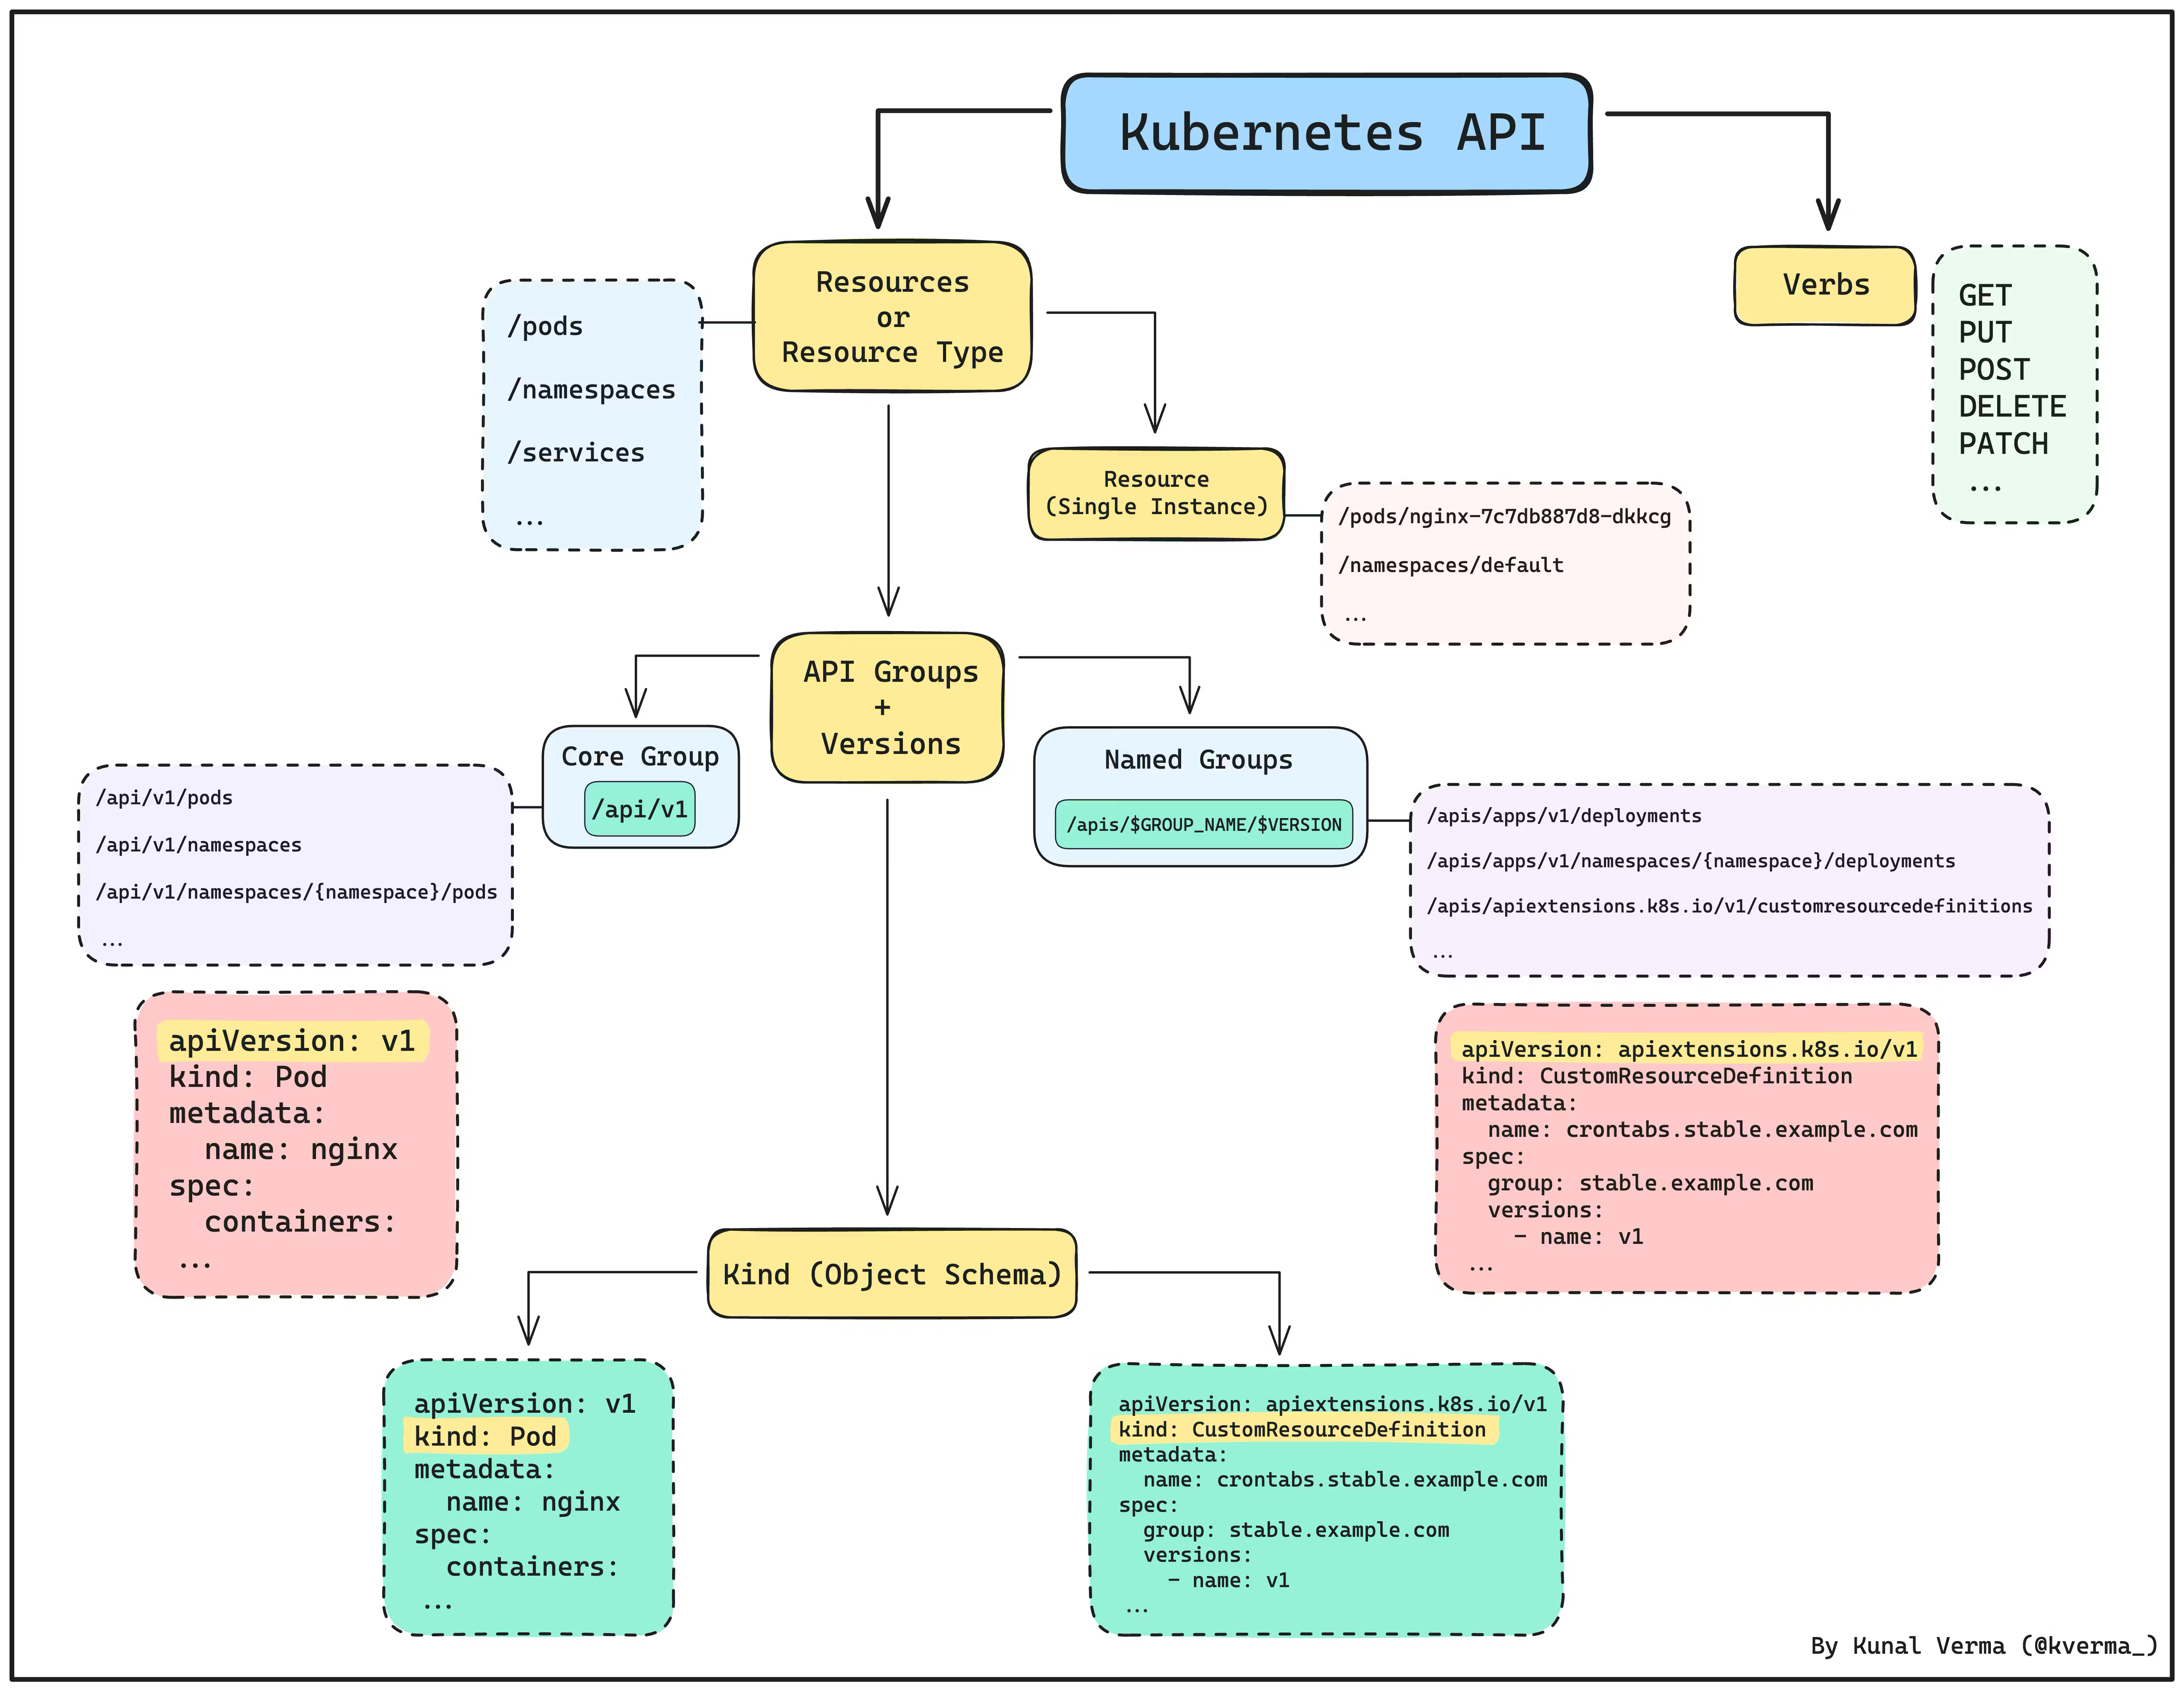
Kubernetes API structure

Slide 4
Custom resource definition
A type of resource that allows to add custom resources known to
Kubernetes
CRD manifest + controller = operator

Slide 5
CRD vs APIService
API endpoints are added automatically.
An endpoint URL is not important

Slide 6
CRD use case
Extend/encapsulate resource management logic
Create a custom workflow

Slide 7
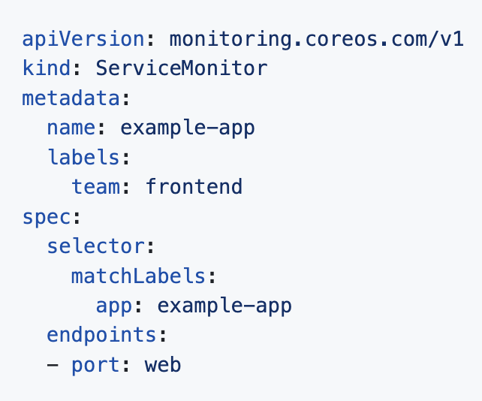
CRD use case: Prometheus operator
…
scrape_configs:
# Scrape Prometheus itself
- job_name: 'prometheus'
static_configs:
- targets: ['localhost:9090’]
- job_name: 'static-targets'
static_configs:
- targets: ['192.168.1.1:9100', '192.168.1.2:9100']
labels:
environment: 'production'
group: 'servers'
# Example of scraping dynamic targets using DNS service discovery
- job_name: 'dns-sd-targets'
dns_sd_configs:
- names:
- 'tasks.example.com'
type: 'A'
port: 9100
refresh_interval: 30s
…

Slide 8
CRD example
apiVersion: apiextensions.k8s.io/v1 kind: CustomResourceDefinition metadata: # name must match <plural>.<group> name: ephemeralvolumeclaims.crd.dev spec: scope: Namespaced group: crd.dev names: kind: EphemeralVolumeClaim plural: ephemeralvolumeclaims singular: ephemeralvolumeclaim shortNames: - evcs - evc versions: - name: v1 served: true storage: true schema: openAPIV3Schema: type: object properties: spec: type: object x-kubernetes-preserve-unknown-fields: true status: type: object x-kubernetes-preserve-unknown-fields: true

Slide 9
CRD example
apiVersion: apiextensions.k8s.io/v1 kind: CustomResourceDefinition metadata: # name must match <plural>.<group> name: ephemeralvolumeclaims.crd.dev spec: scope: Namespaced group: crd.dev names: kind: EphemeralVolumeClaim plural: ephemeralvolumeclaims singular: ephemeralvolumeclaim shortNames: - evcs - evc versions: - name: v1 served: true storage: true schema: openAPIV3Schema: type: object properties: spec: type: object x-kubernetes-preserve-unknown-fields: true status: type: object x-kubernetes-preserve-unknown-fields: true

Slide 10
CRD controller implementation options
Implementation from scratch
KOPF python library

Slide 11
KOPF library vs implementation from scratch
Advantages of KOPF:
- Abstracts away boilerplate (event types, run in a thread) - Automatic Retry on error - connect the custom resource to a child resource with one line - built-in ability to filter on fields, annotations

Slide 12
KOPF library vs implementation from scratch
Advantages of KOPF:
- Abstracts away boilerplate (event types, run in a thread) - Automatic Retry on error - connect the custom resource to a child resource with one line - built-in ability to filter on fields, annotations

Slide 13
When to use CRD or APIService
CRD
APIService
Simpler to implement
Native management (e.g. kubectl get <cr name>)
Custom workflows based on resource manipulation
Performance
Complex endpoints (e.g. query params)
Custom authentication

Slide 14
Other
Webhooks
Open Service Broker API

Slide 15
Next steps
TODO: what’s next

Slide 16
Fine art

Slide 17
References
CRD official documentation
Python operator tutorial
Python operator tutorial repo
Kopf documentation

Slide 18
Questions?

